Slide 1
Williamson’s Sapsucker
Best Management Practices
Western (Thompson) Area of Occupancy

Slide 2
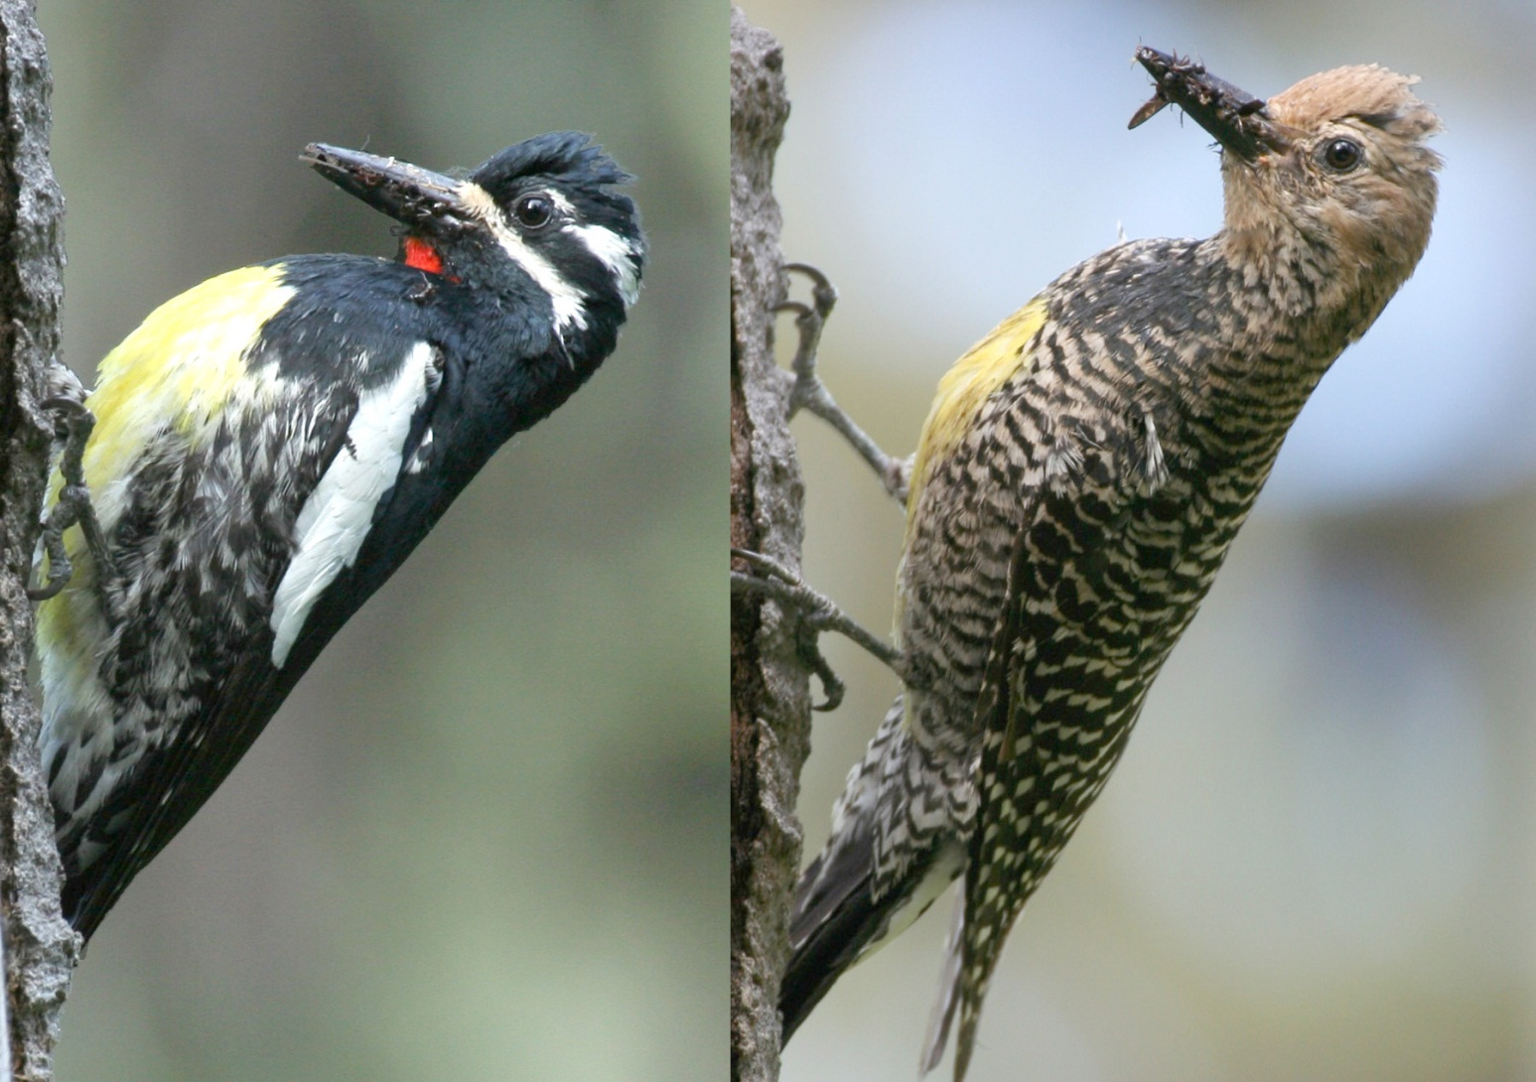
Status – Blue listed in BC , Endangered in Canada

Slide 3
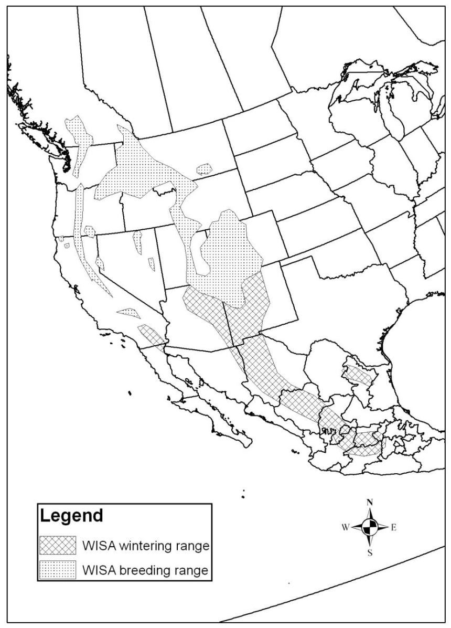

Slide 4
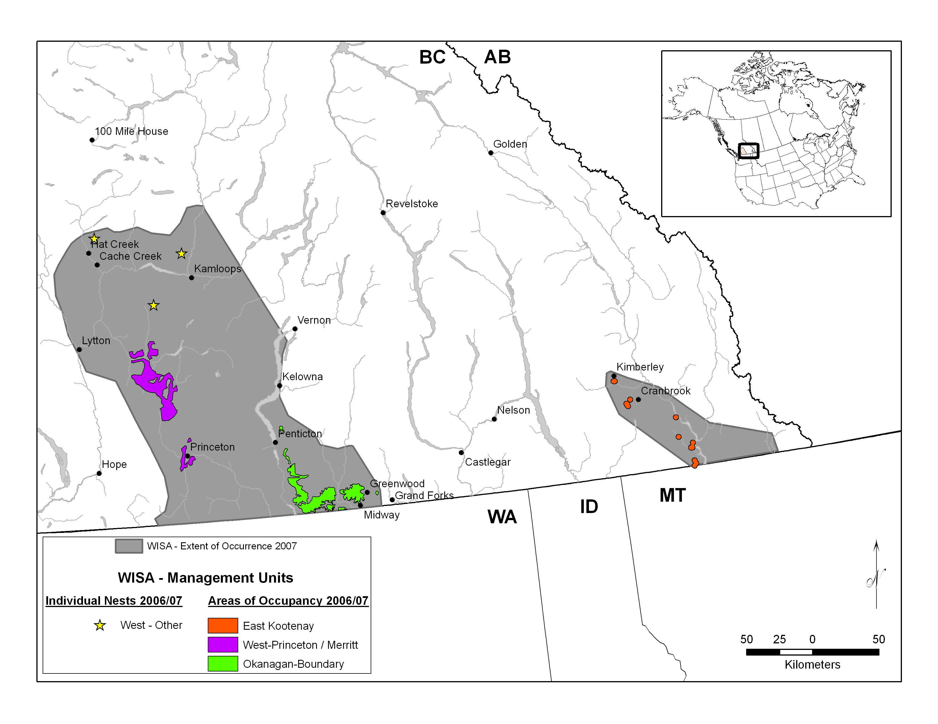

Slide 5
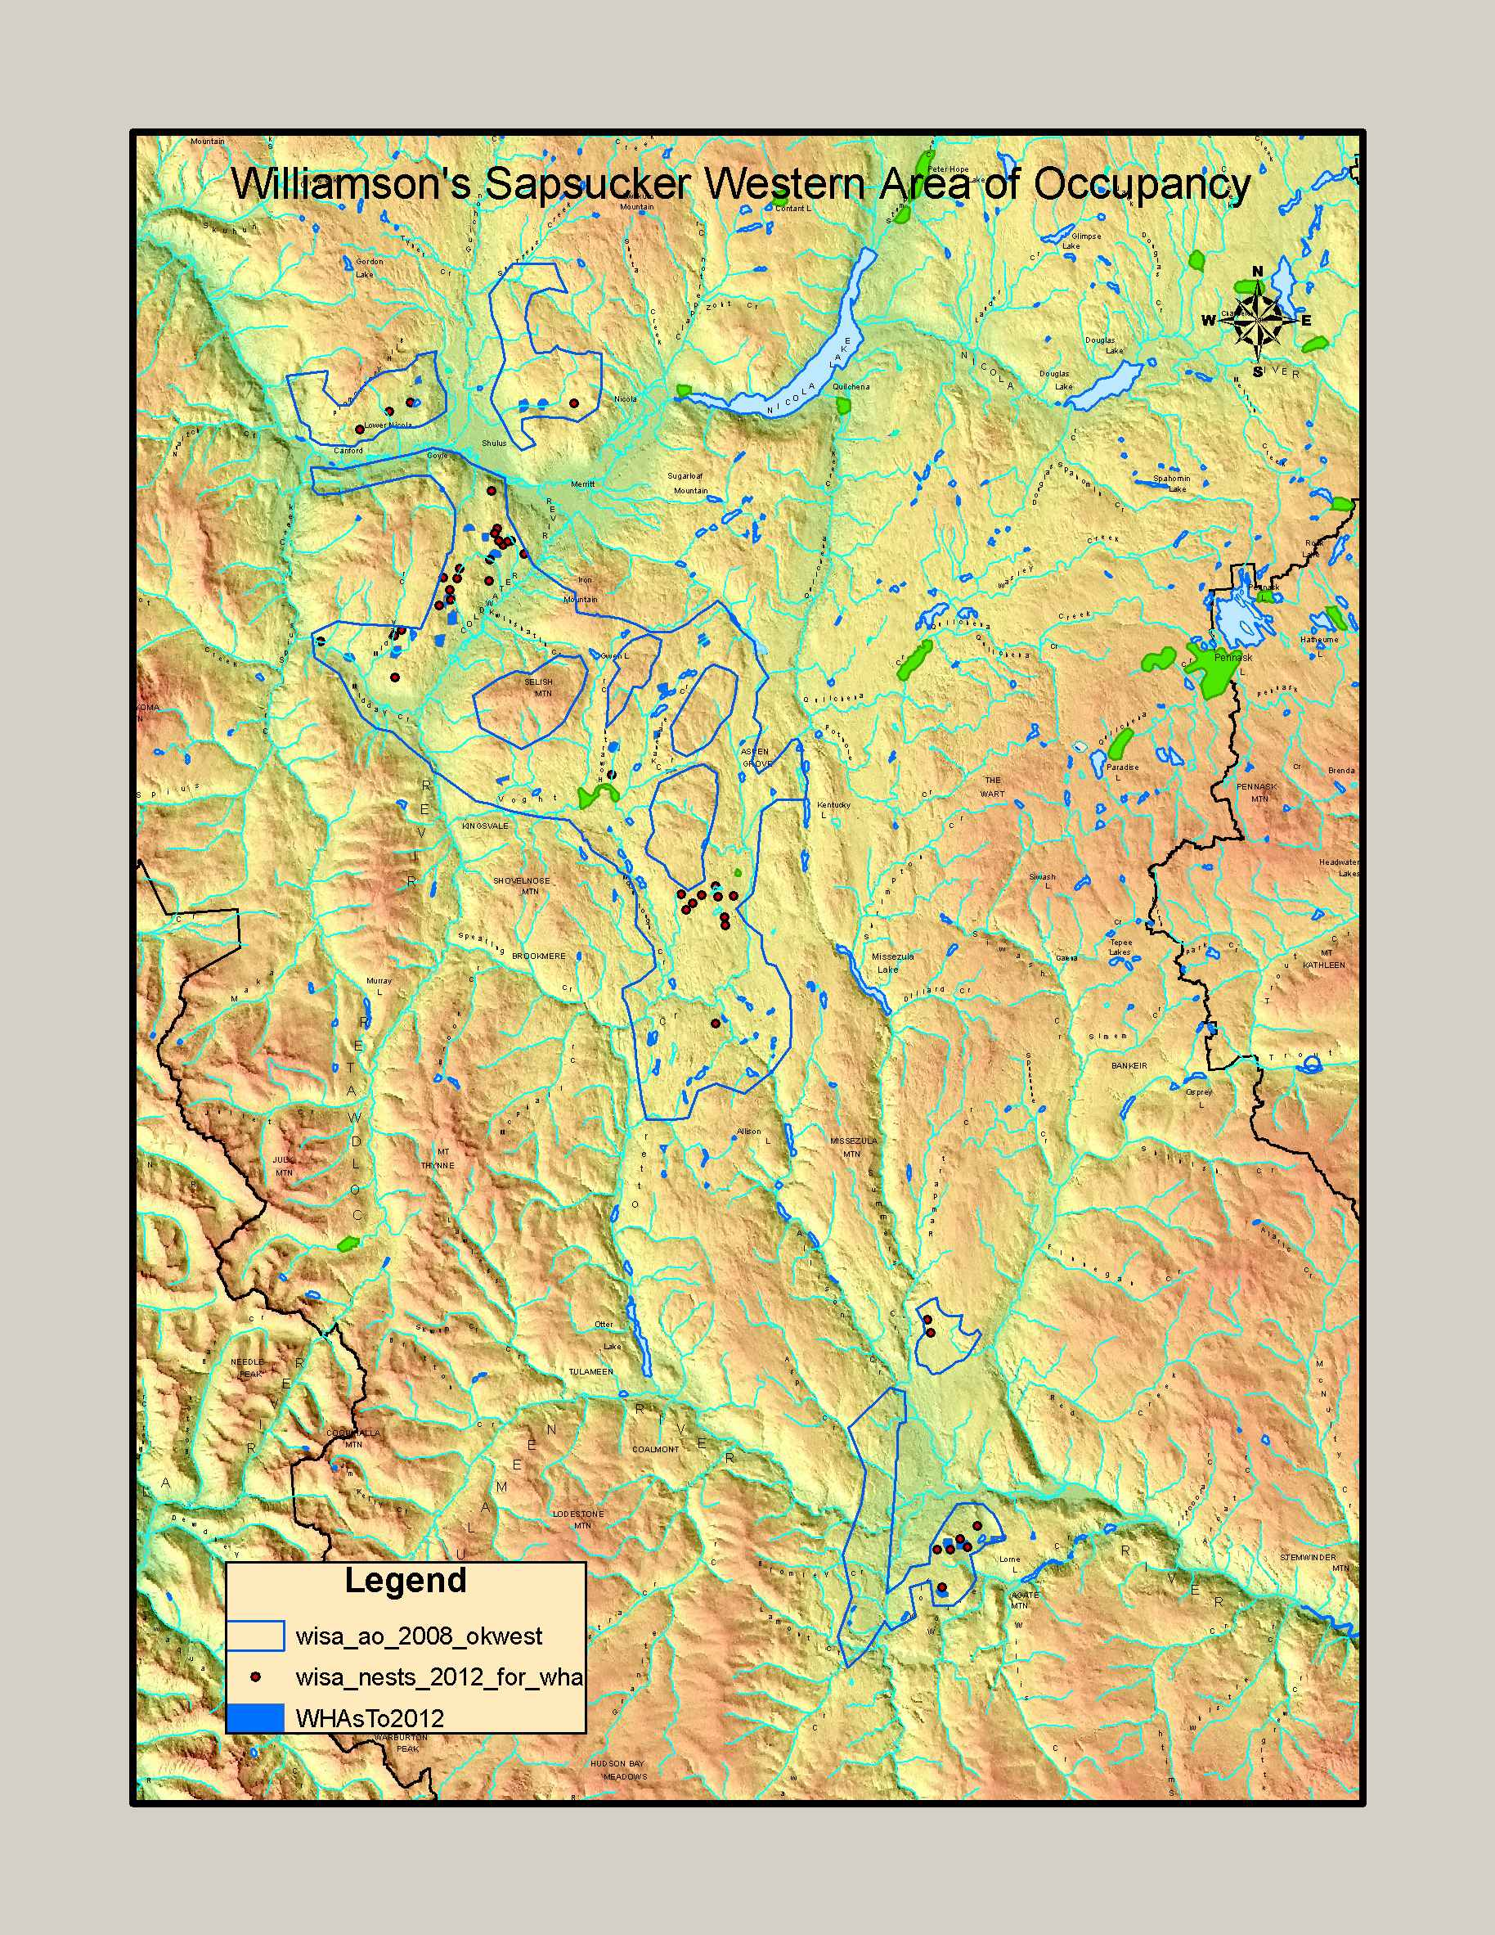

Slide 6
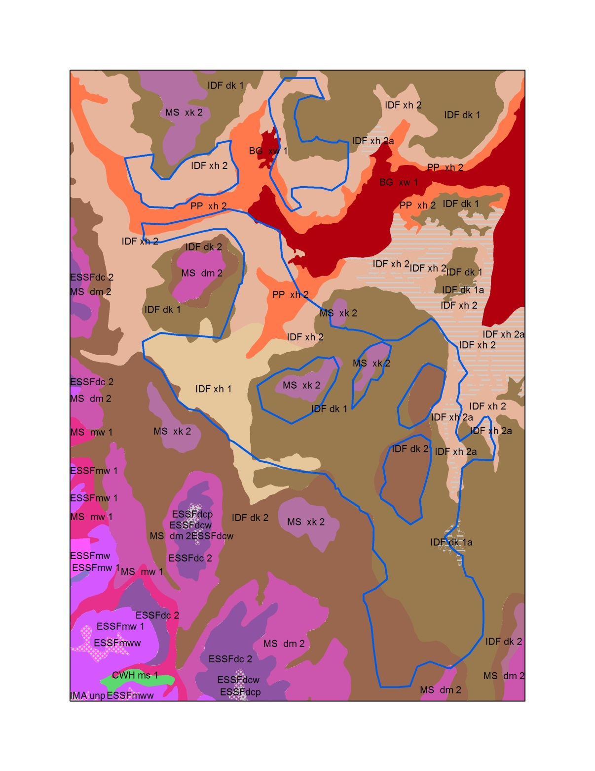

Slide 7
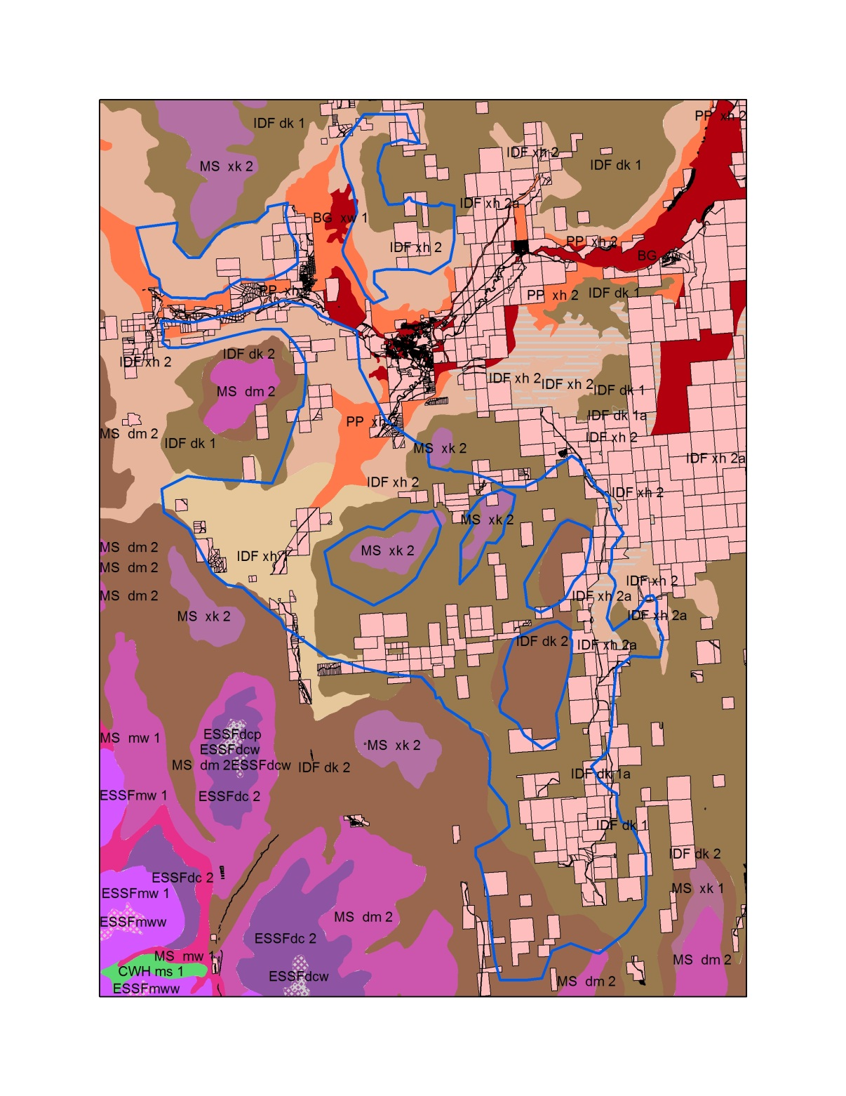

Slide 8
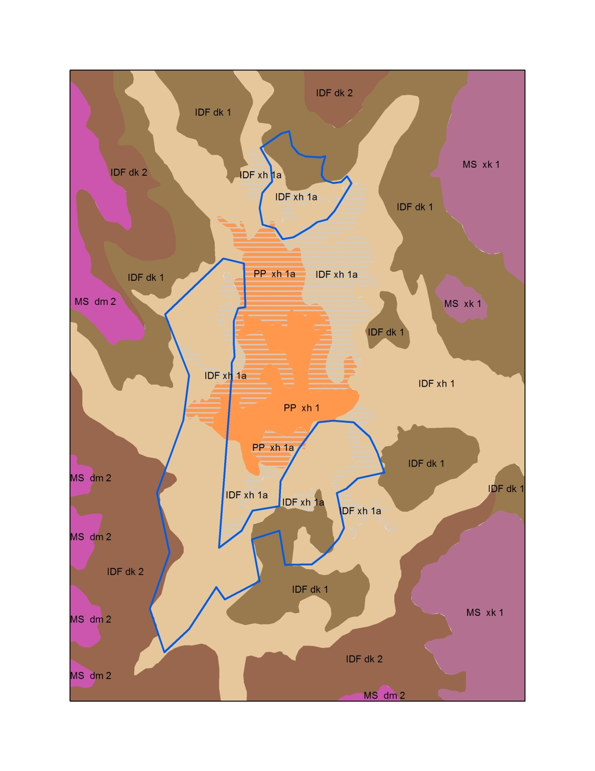

Slide 9
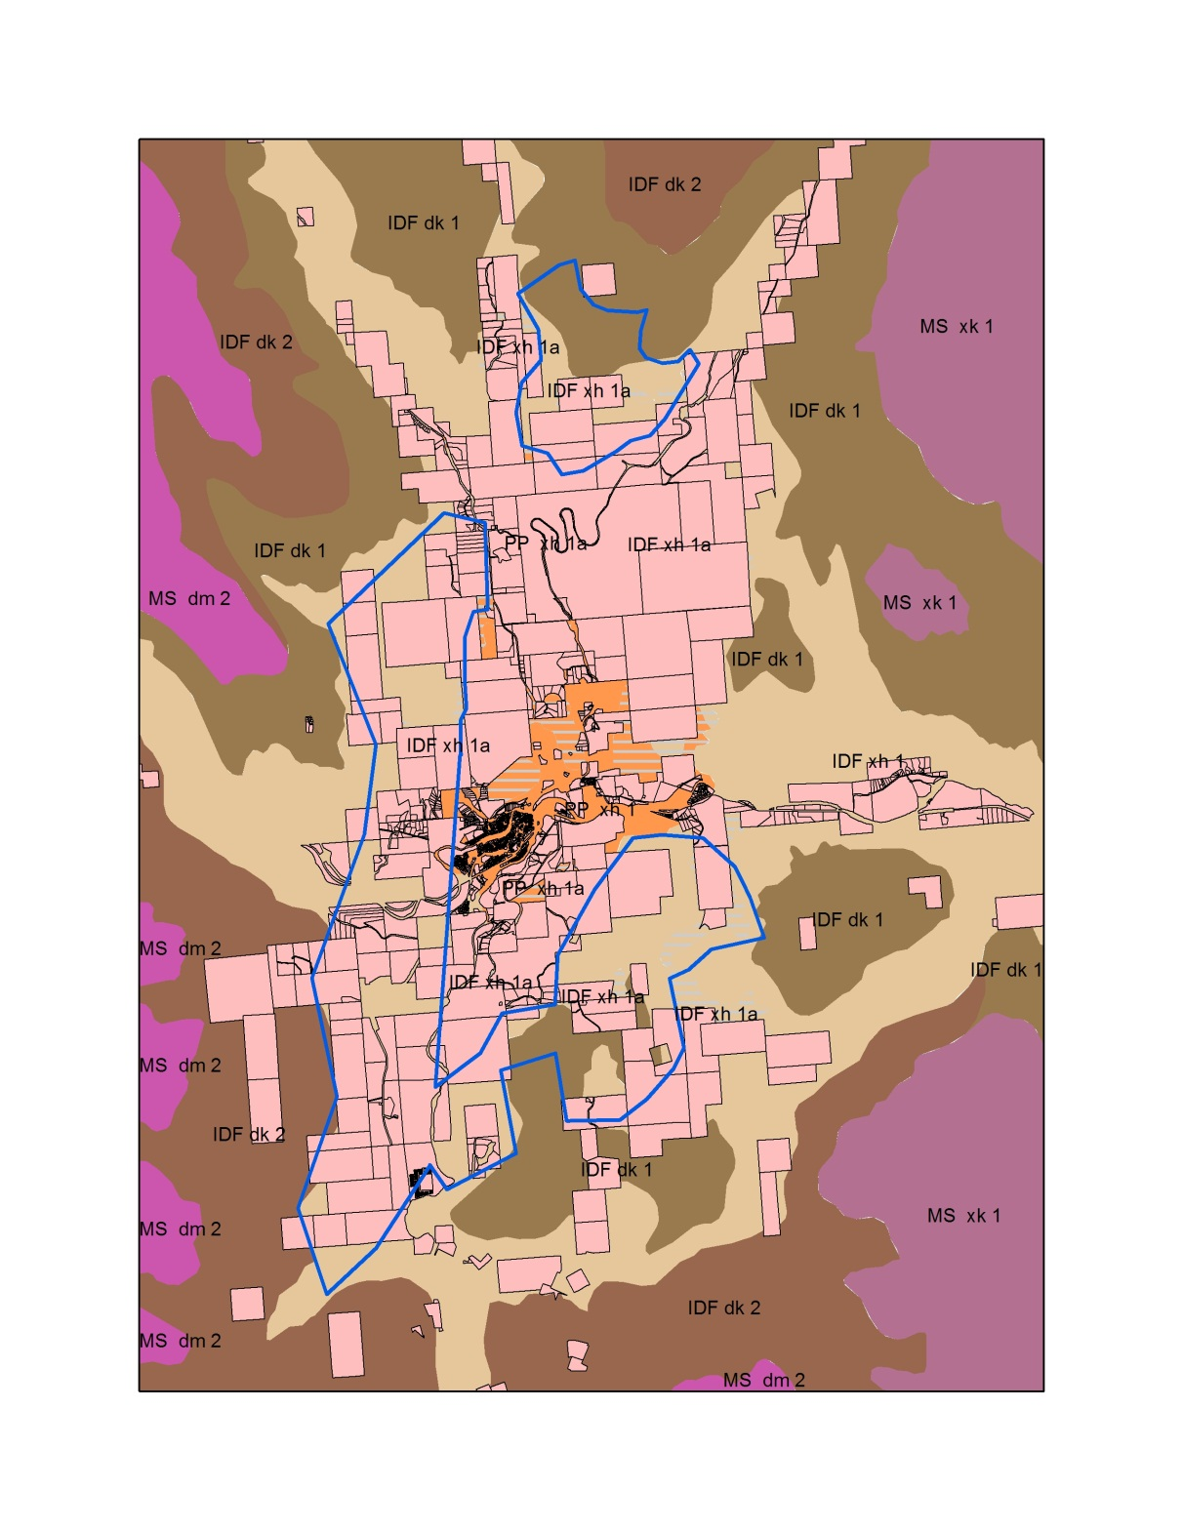

Slide 10
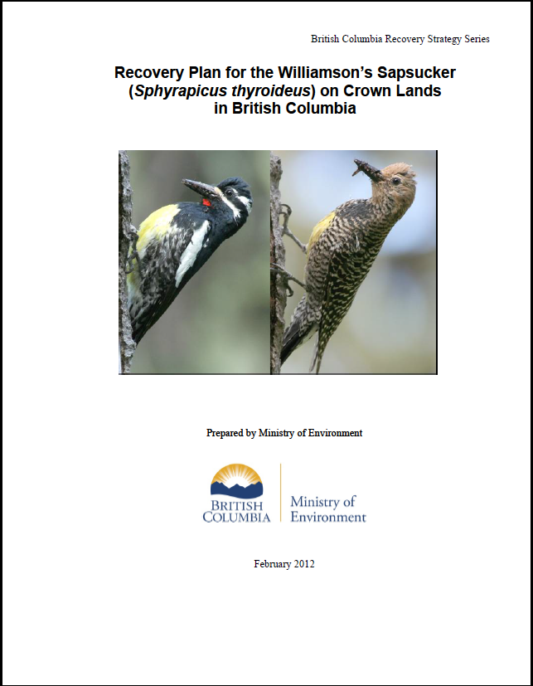
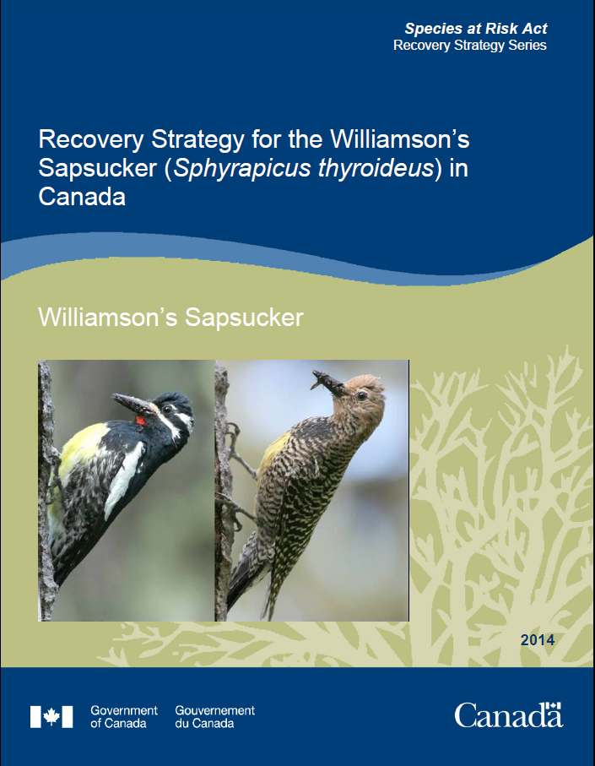
Recovery Strategies

Slide 11
Recovery Strategy
The population and distribution objective:
Ensure the persistence of the population in Canada within each of the identified areas of occupancy by maintaining them at or above: 1) the current abundance; 2)the current distribution and area of occupancy; allowing for natural fluctuations in both cases.

Slide 12
Critical habitat
Critical habitat is identified as areas containing suitable habitat (low, medium, or high suitability)
“Understanding what constitutes destruction of critical habitat is necessary for the protection and management of critical habitat. Destruction would result if part of the critical habitat were degraded, either permanently or temporarily, such that it would not serve its function when needed by the species”
Notes:
habitat (defined as habitat rated as low, medium, or high suitability by the habitat suitability model
Low = (63% of known nests,

Slide 13
Critical Habitat
Table 5. Examples of activities likely to result in destruction of critical habitat for Williamson’s Sapsucker.
Habitat feature destroyed
Biological function lost
Removal of any known nest tree
Significant removal of suitable nest trees
Removal of ant nests in woody substrate

Slide 14
Critical Habitat
“To ensure that the suitability of critical habitat is not degraded, it is recommended that habitat- and region-specific retention targets/removal limits be established through provincial Best Management Practices or regulatory means.”

Slide 15
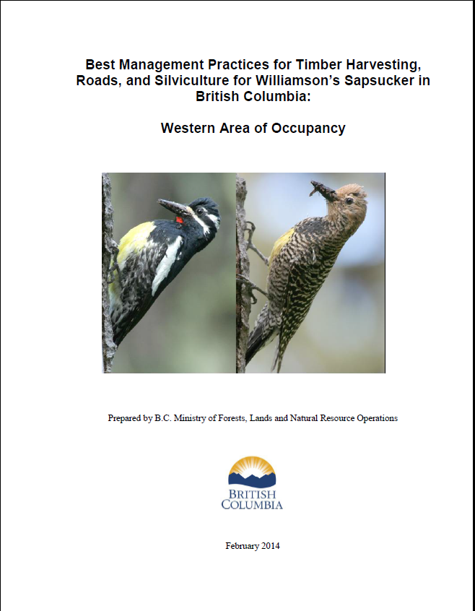
Best Management Practices

Slide 16
Best Management Practices
BMPs = stand level management
  suitable nest trees for cavity nesting
  greater than 85 live trees per hectare > 17.5 cm dbh
  coniferous trees for sap trees
  woody debris that supports ants

Slide 17
Nest productivity was significantly lower for the lower tree density class in the foraging territory (60-225m from nest)
Tree densities <85 sph in the entire foraging territory (i.e. 225m radius from nest tree) was negatively associated with nest success
7.4% of breeding territories occurred where tree density was <75sph
Notes:
Average live tree densities that provide suitable habitat appear to have lower and upper limits. Gyug et al. (2010) noted that breeding territories were found infrequently where live tree densities were < 75 trees/ha (7.4%) or > 275 trees/ha (6.7%). In an examination of Williamson’s Sapsucker nest productivity at 160 nests across the three AOs, Gyug et al. (2010) found significantly lower productivity (i.e., 25% of nests failed, n = 20) where average live tree densities were between 25 and 85 trees/ha (trees >18 cm dbh) within the sample area surrounding the nest tree, compared to nest stands with 85–425 trees/ha (10% of nests failed, n = 140). Although breeding territories were observed at lower average tree densities (e.g., 75 trees/ha), a greater number of failed nests was also observed when the average stand density across a breeding territory was < 85 trees/ha. This study (Gyug et al. 2010) suggests that a minimum average stand density of > 85 live trees/ha are generally needed to provide suitable habitat.

Slide 18
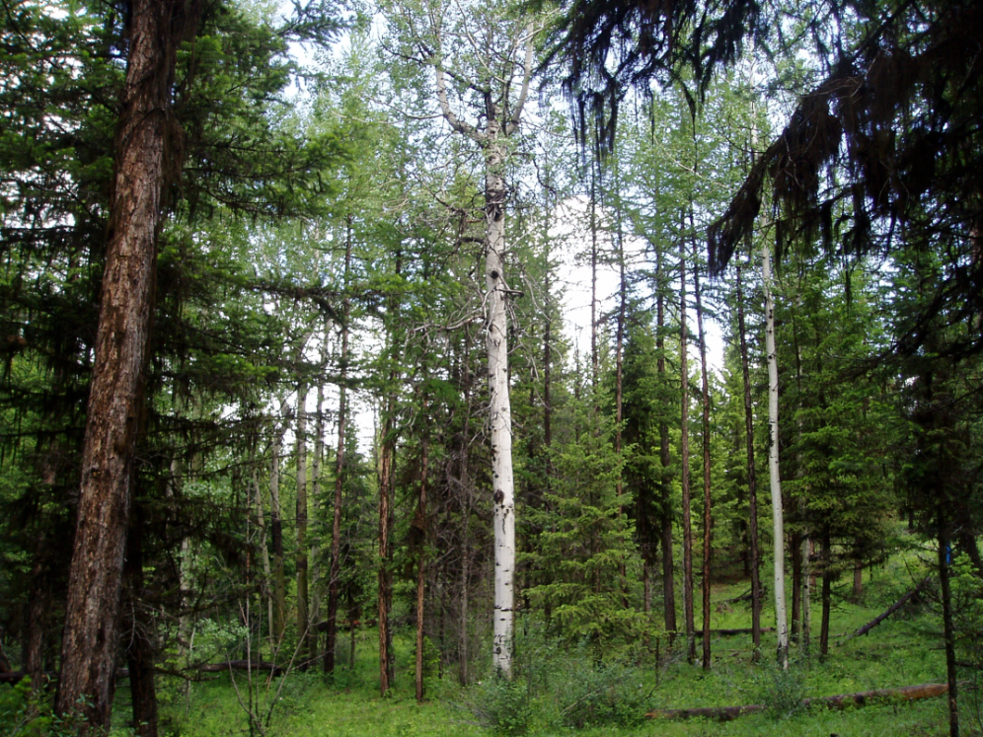
Nest Trees
Applies to low and moderate habitat suitability classes
“Nest trees are the required habitat attribute in shortest supply across the AOs in general and are probably the most critical single habitat requirement” (Gyug et al. 2009a).
The minimum nest tree target is 14 existing and/or suitable nest trees per hectare.

Slide 19
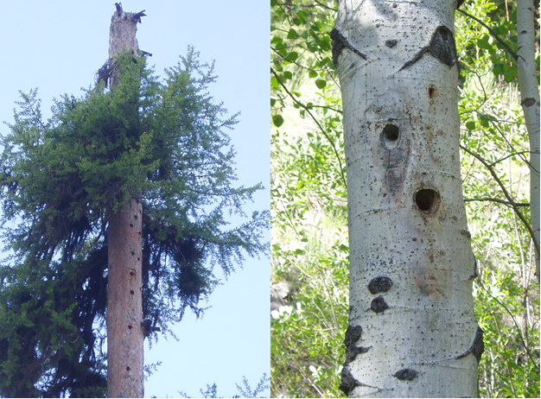
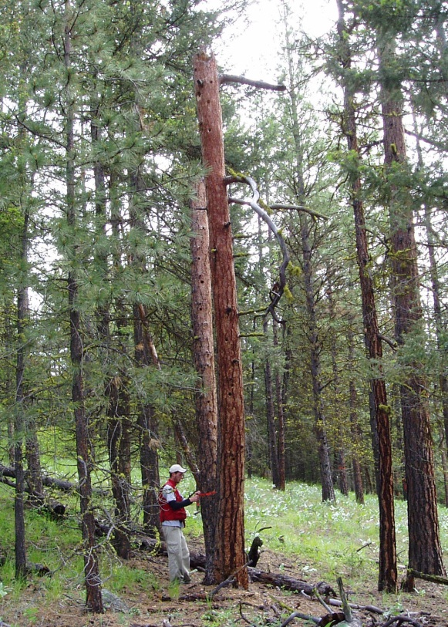
Nest Trees
Suitable nest trees are the largest trees available on site from among live trees with signs of internal decay and dead trees of the following species, in order of preference: trembling aspen > 22 cm dbh; and ponderosa pine or Douglas-fir > 35 cm dbh.
If nest tree targets cannot be met in the short term, then retain all suitable trees plus trees identified as recruitment trees to make up to the target density.

Slide 20
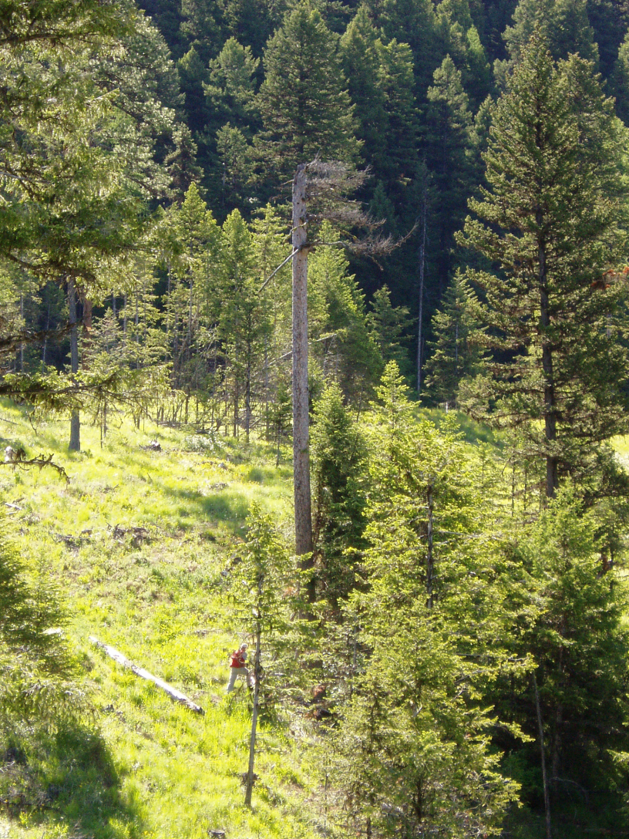
Live Tree Retention Targets
Applies to moderate and low habitat suitability classes
Live tree retention targets include any live trees retained for nest tree retention and recruitment.

Slide 21
Live Tree Retention Targets
Live tree retention within suitable habitat on a block must average between 85 and 275 stems per hectare > 17.5 cm dbh (see Table 1).
The minimum live tree retention for any given hectare within the harvested area should be ≥ 20 live trees > 17.5 cm dbh.
Include a mix of the preferred tree species (ponderosa pine, Douglas-fir, and trembling aspen) in a range of size classes. Trembling aspen should not contribute > 25% of live tree retention target to any block.

Slide 22
Live Tree Retention Targets
Table 1. Live tree retention targets (> 17.5 cm dbh) and the percent area of new blocks (blocks established after April 1, 2014) to be retained in the target classes for each licensee.
Average live tree
Retention target
(trees per hectare) % area of new blocks
for each licensee
85–125 5–15
126–175 25–35
176–225 40–50
> 225 10–20

Slide 23
Sap Tree Habitat Targets
Sap trees are required for sap well creation and adult feeding throughout the breeding and post-breeding season.
Sap trees are most often mid-sized Douglas-fir (15–50 cm dbh)
Unhealthy Douglas-fir seems to be preferred over healthy ones.
Achieving live tree retention targets should address sap tree requirements.

Slide 24
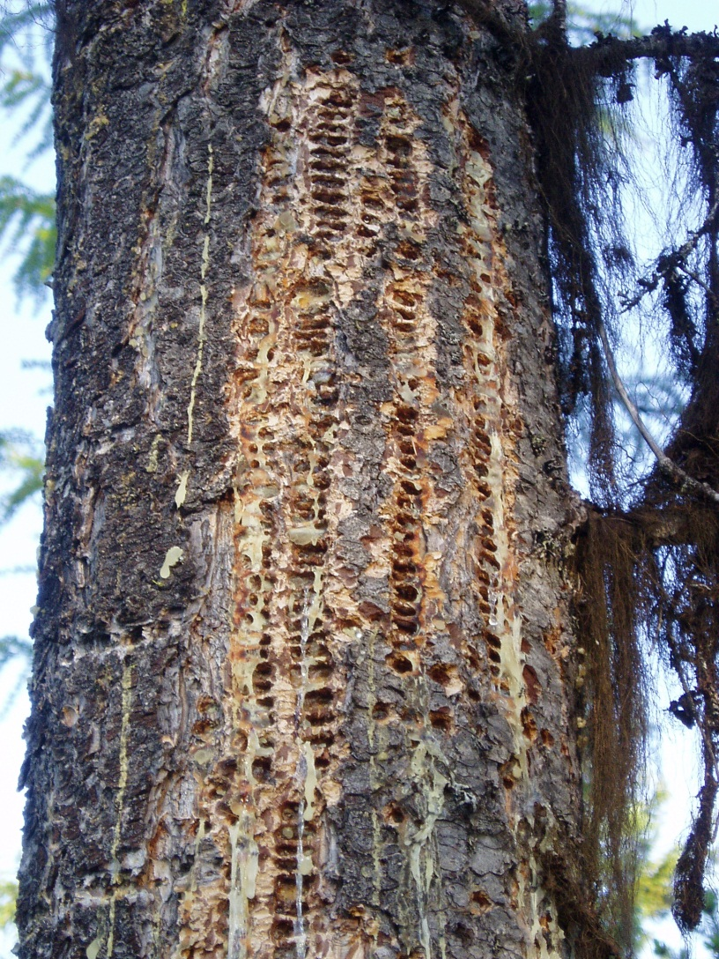

Slide 25
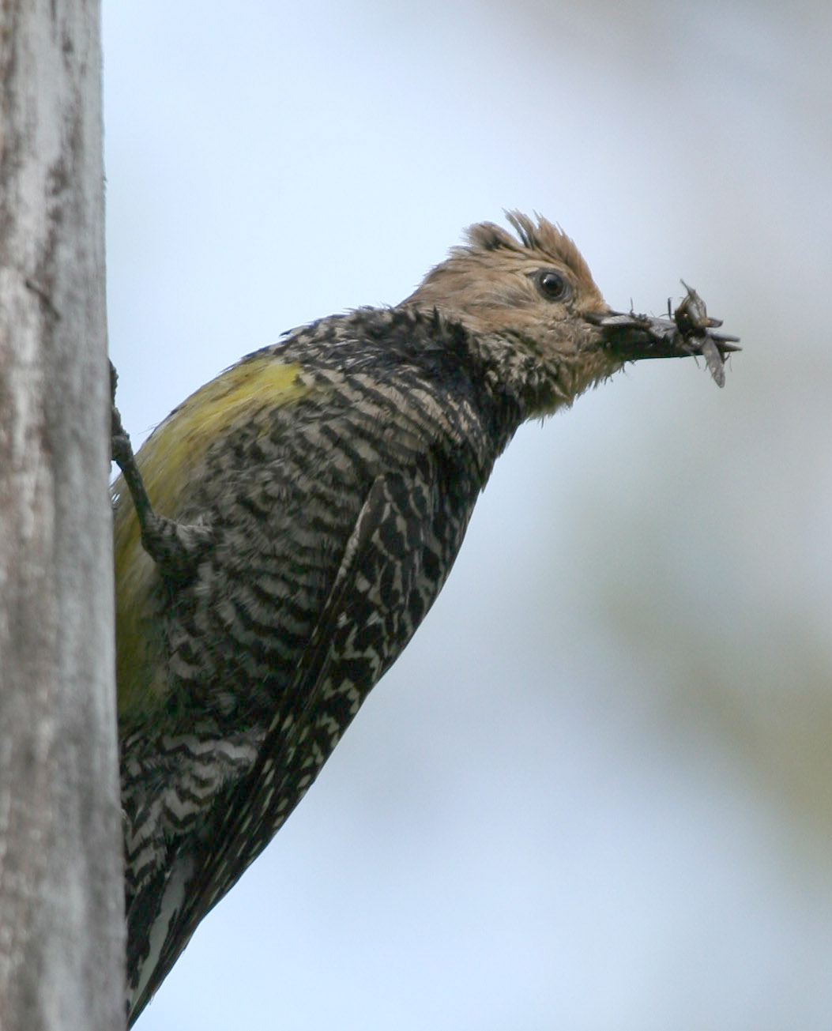
Ant Habitat Targets
Carpenter Ants make up
80-99% of nestling diet

Slide 26
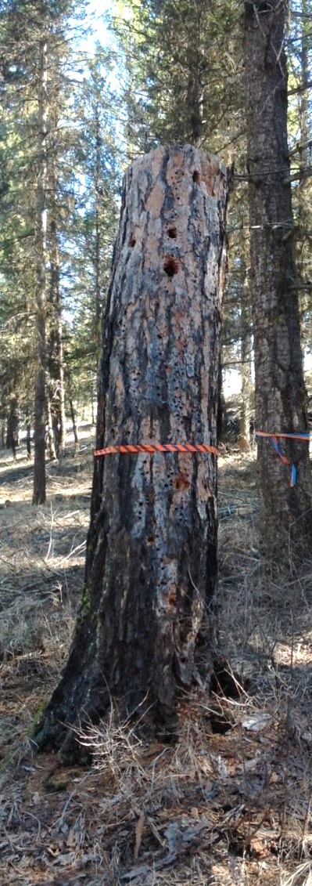
Leave as much existing coarse woody debris (CWD) on site as is practicable.
Take measures to protect existing large high value CWD from damage. Veteran (> 60 cm dbh) ponderosa pine are the highest value CWD.

Slide 27
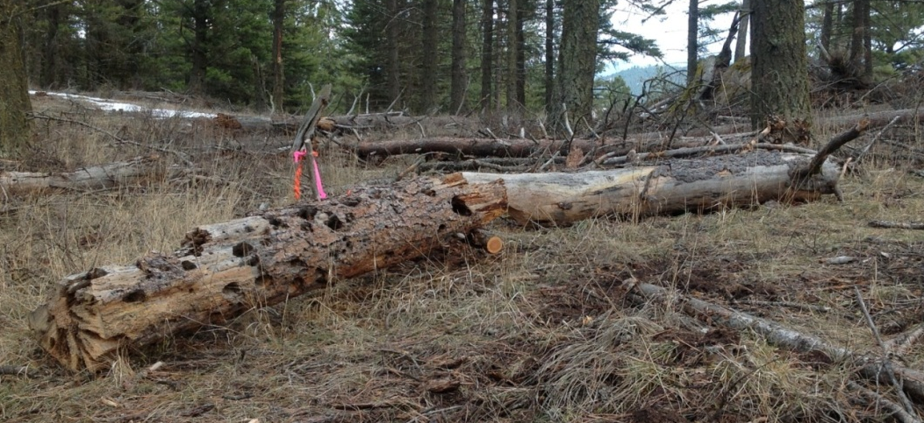
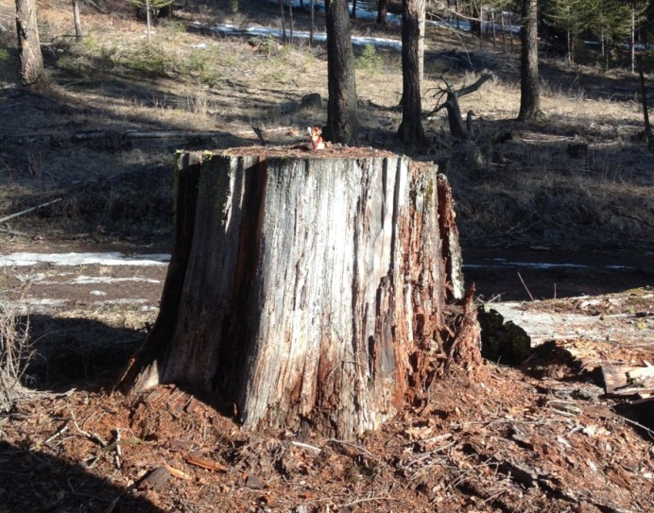
Where available leave 15 m3/ha of large CWD (>30cm large-end diameter)
If volumes >15m3/ha are available onsite pre-harvest, efforts should be made to retain this during harvest

Slide 28
